Slide 1
Molija B
Final Project

Slide 2
PROJECT TITLE Generating Output with Generative Adversarial Networks (GANs)

Slide 3


AGENDA 1 Problem Statement 2 Project Overview 3 End Users 4 Solution and Value Proposition 5 The Wow Factor 6 Modelling 7 Results
3/21/2024 Annual Review

Slide 4

PROBLEM STATEMENT Generating realistic and diverse data samples is a challenging task in various domains, including computer vision, natural language processing, and audio synthesis. Traditional techniques often struggle to capture the complexity and nuances of real-world data distributions. This project aims to leverage the power of Generative Adversarial Networks (GANs) to generate high-quality synthetic data that can be used for various applications, such as data augmentation, content creation, and domain adaptation.

Slide 5

PROJECT OVERVIEW This project explores the use of Generative Adversarial Networks (GANs) to generate synthetic data samples. GANs are a type of generative model that consists of two neural networks: a generator and a discriminator. The generator network learns to produce realistic data samples, while the discriminator network learns to distinguish between real and generated samples. Through this adversarial training process, the generator improves its ability to generate realistic data that can fool the discriminator.

Slide 6
WHO ARE THE END USERS? >Research and academic communities: Researchers in fields like computer vision, natural language processing, and audio synthesis can use the generated data for various purposes, such as data augmentation, domain adaptation, and model training. > Creative industries: Content creators, artists, and designers can leverage the generated data to produce new and unique content, explore creative ideas, or augment their existing work. > Healthcare and biomedical industries: GANs can be used to generate synthetic medical images, patient data, or drug molecule structures, which can aid in research, diagnosis, and drug discovery processes. >Finance and marketing: Synthetic data generated by GANs can be used for tasks like customer segmentation, marketing campaign optimization, and financial risk modeling.

Slide 7

YOUR SOLUTION AND ITS VALUE PROPOSITION Our solution leverages the power of Generative Adversarial Networks (GANs) to generate synthetic data samples that are highly realistic and diverse. By training a GAN on real-world data, our model learns to capture the underlying patterns and distributions, enabling it to generate new samples that are indistinguishable from the original data. The value proposition of our solution is threefold: Data augmentation Privacy preservation Creativity and exploration

Slide 8

THE WOW IN YOUR SOLUTION The "wow" factor in our solution lies in the ability of GANs to generate highly realistic and diverse data samples that are almost indistinguishable from real data. By leveraging advanced neural network architectures and training techniques, our solution can capture complex patterns and distributions, enabling the generation of data that mimics the nuances and subtleties of real-world data. Additionally, our solution offers flexibility and scalability, allowing users to generate data in various domains, such as images, text, audio, or even video, by simply adjusting the architecture and training data of the GAN model.
3/21/2024 Annual Review
8

Slide 9
MODELLING
In this project, we employ state-of-the-art GAN architectures and training techniques to ensure the generation of high-quality data samples. Some of the key modeling aspects include:
Generator and discriminator architectures: We explore different neural network architectures, such as convolutional neural networks (CNNs) for image data, recurrent neural networks (RNNs) for text data, and variational autoencoders (VAEs) for structured data.
Training techniques: We employ advanced training techniques, such as gradient penalty regularization, spectral normalization, and progressive growing of models, to improve the stability and convergence of GAN training.
Conditional generation: Our solution supports conditional generation, where the GAN model can generate data samples conditioned on specific attributes or labels, enabling greater control over the generated output.
Transfer learning and domain adaptation: We investigate techniques for transfer learning and domain adaptation, allowing our models to leverage knowledge from related domains and adapt to new data distributions.
9

Slide 10
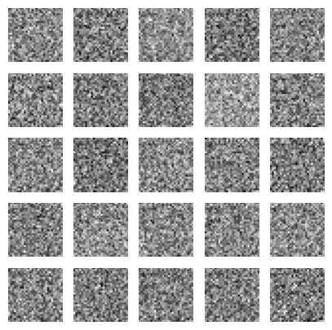
RESULTS Our solution has demonstrated impressive results in generating realistic and diverse data samples across various domains. We continuously evaluate and benchmark our solution against state-of-the-art techniques, ensuring that we provide cutting-edge performance and quality in generating synthetic data samples.
1/1 [==============================] - 0s 238ms/step
10

